Slide 1

Project title
Research title
Date of readout presentation

Slide 2
A best practice: 50-60 words per slide
What does 50 words look like?
In paragraph form, 50 words should give you roughly a paragraph of information. You can probably get 3 to 4 sentences depending on their length. Try to present the most informational or important information on the slide. You can verbalize additional information as needed.
The content above is fifty words. (we’re at sixty now)

Slide 3
A best practice continued
What does 50 words look like?
In lists, use four or five list items per slide
Each list item should contain about ten words or less
It’s ok to go over or under ten words per list item
Avoid reading your lists or paragraphs - let your audience read the information
The content above is fifty words. (we’re at sixty now)

Slide 4
Agenda
Start with your agenda: what are you sharing?

Slide 5
Research plan

Slide 6
Background
Provide background information on the research - what does your audience need to know about the project to understand the outcomes and results of the research?
You could mention who the users are, what the feature or product does, etc.

Slide 7
Research information
Share how the research was conducted - was it a survey or interviews? Zoom or in-person? How many questions? What types of questions: rating, satisfaction, open-ended, etc.
Who was on the research team? What were their roles?
Consider adding images of each person, or a descriptive visual of each role, or some screenshots from interviews (and don’t forget alt text if needed!)

Slide 8
Research goals
Share what the goals of the research are
It’s a best practice to lead with the goals which the results support and demonstrate
It’s also suggested to plan for at least one slide per goal
More slides are acceptable
Planning for “one-slide-per-goal-minimum” can help determine what to include and what can be referenced later (or referenced back to the plan itself)

Slide 9
Research hypothesis
Share your hypotheses
These hypotheses should follow the “one-slide-per-hypothesis” idea
You can group hypothesis and goal together in a slide if they align
A hypothesis can be similar or the same as a goal, but it likely isn’t.

Slide 10
Survey stats
Share your stats
How many participants? How many requested?
How many surveys completed? Out of how many?
How long did the survey/interview/call last?
How many questions?
Include graphics, charts, etc on to help break up walls of text (don’t forget alt text if needed!)

Slide 11
Key findings

Slide 12
Information analysis
Share how you analyzed, synthesized, or quantified the data - what were the metrics? What were the groupings?
Talk about how you synthesized the information and why you chose that method. Did you use Mural? Why? Google Analytics? Why?

Slide 13
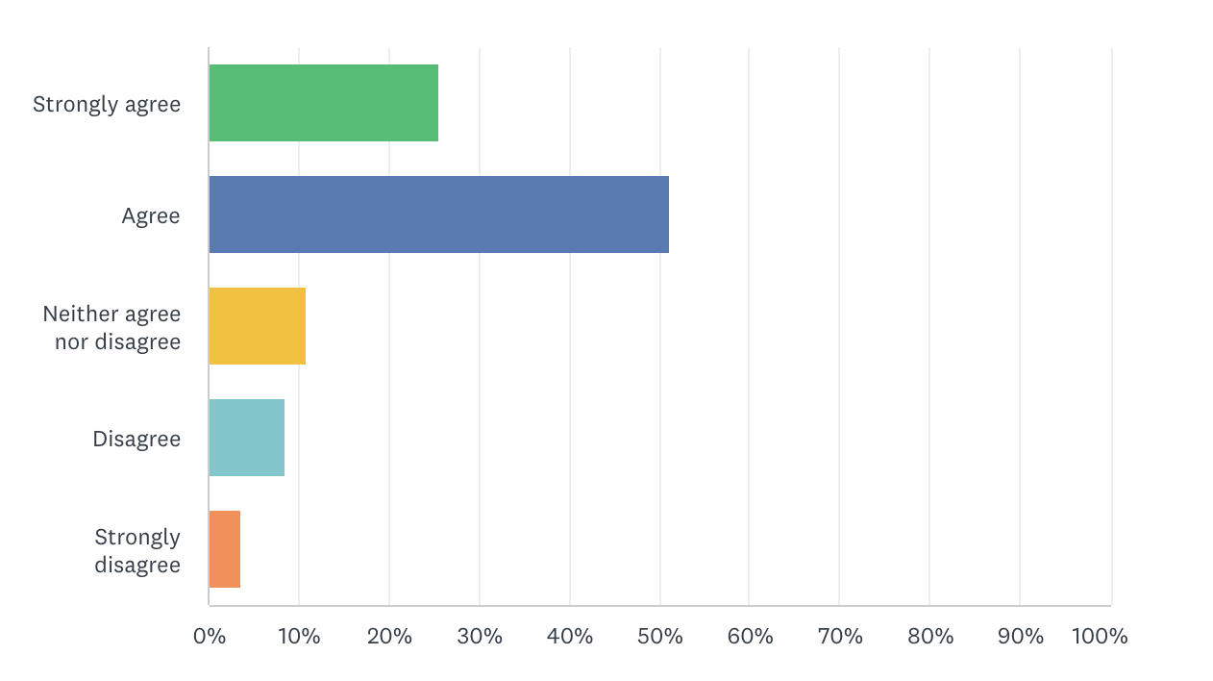
Results
Here’s the first goal or hypothesis
Add the data and responses that support or invalidate your goal/hypothesis
Include charts and graphs as needed or beneficial (don’t forget alt text if needed!)

Slide 14
Results
Here’s the second goal or hypothesis
Add the data and responses that support or invalidate your goal/hypothesis
Be mindful of cognitive overload. Shoot for about 50-60 words
Adjust your textbox width if not including graphs or charts

Slide 15
If you can, working direct user quotes into the results and data can help support the research; for example
Of 61 respondents who answered this question:
20 found the shadowing assignment the most useful
14 found the course resources and case studies the most useful
11 found the stakeholder assignment the most useful
“The shadowing assignment was useful because it provided the opportunity to see the concepts in real time.”

Slide 16
Don’t be afraid to share the negative data too. Framing is important, but it’s also important for stakeholders to know what isn’t working too
Don’t forget to center your text and images!

Slide 17
Proposals

Slide 18
Start, Stop, Continue
An easy way to tie suggestions to the goals and hypotheses is to run the results through a start, stop, continue exercise
Dedicated one (or more) slides to each verb
Connect the dots to the goals and hypotheses when possible
Include screenshots or working prototype links if available

Slide 19
Discuss what didn’t work
Share any hypotheses that were disproved or goals that you didn’t achieve Also, review your slides - make sure any goals and hypotheses have slides

Slide 20
What’s next?

Slide 21
Next steps
Describe what’s next
What will you do as a result of the research?
How did the research impact these decisions?
Share any roadmaps, ticketed work, or future research plans if they’re related to this research

Slide 22
Questions?

